Slide 1
Controls
Introduction
Estia Modbus
BMS-IFMB0AWR-E
EMEA Training 2017
Presentation Reference TP17-T3-01

Slide 2
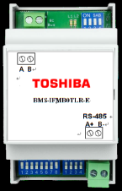
Introduction:
The BMS-IBM0AWR-E 1-1 Estia Modbus controller is compatible with Estia 4 & 5 series models. The BMS-IBM0AWR-E is available to purchase end of November 2017.
This presentation will include the key information required to design and install the BMS-IBM0AWR-E interface.
Line-Up
Model Number | Connectable Units | Description
BMS-IFMB0AWR-E | 1-1 | Estia ModBus
NOTE:
Cannot be used in conjunction with other TCC-Link Controllers.

Slide 3
Introduction:
The BMS-IBM0AWR-E 1-1 Estia Modbus controller is compatible with Estia 4 & 5 series models. The BMS-IBM0AWR-E is available to purchase end of November 2017
This presentation will include the key information required to design and install the BMS-IBM0AWR-E interface.
Applicable Models

Slide 4
Line-Up
Product Overview
Product line up & Features
Specification
Hardware
Software / Variable Specification
Installation
Dimension
Installation
Wiring
Device Setup

Slide 5
Product Overview
Model name | Appearance | Performance
BMS-IFMB0AWR-E |  | Hardware for MODBUS protocol Max. 8 ESTIA Hydro Units(*1) Applicable for 5 Series and 4 Series Manual (*2): EN, DE, ES, FR, IT, TR

Slide 6
New
Control
Monitor
Zone1/2 HW ON/OFF
Operation Mode
Zone1/2 HW Set Temp.
Auto Temp ON/OFF
Night Set Back ON/OFF
HW Boost ON/OFF
Frost Protection ON/OFF
Anti-Bacteria ON/OFF
Zone1/2 HW ON/OFF
Operation Mode
Zone1/2 HW Set Temp.
Auto Temp ON/OFF
Night Set Back ON/OFF
HW Boost ON/OFF
Frost Protection ON/OFF
Anti-Bacteria ON/OFF
Water Temp
Alarm Status
Alarm Code
Operation Hour
…

Slide 7
Specification
Specification
Power supply | Power Supply from Indoor unit
Dimensions | H90(93)×W53×D58mm
Weight | 85 g
Operation environment | Temperature:0～+40 deg / Humidity :10～80%

Slide 8
Protocol Specification
Character length = 8 data bits, no parity and 1 stop bit
Baud Rate : 2400, 4800, 9600 (Default), 19200
Support Function : 0x03 Read Holding Register
0x06 Write Holding Register
0x10 Write Multiple Holding Register

Slide 9
Variable Specification
Addr | R/W | Item |  | 5 Series | 4 Series
0 | R/W | Zone1/2 ON/OFF setting/monitor | 0 : OFF 1 : ON | ✓ | ✓
1 | R/W | HOT WATER On/Off | 0 : OFF 1 : ON | ✓ | ✓
2 | R/W | Zone1 / Zone 2 Operation Mode setting / Monitor | 1:Heat 2:Cool | ✓ | ✓
3 | R/W | Zone1 Temperature Setting (C) |  | ✓ | ✓
4 | R/W | Zone2 Temperature Setting (C) |  | ✓ | ✓
5 | R/W | HOT WATER Temperature Setting (C) |  | ✓ | ✓
6 | R/W | AUTO TEMP operation On/Off | 0 : OFF 1 : ON | ✓ | ✓
7 | R/W | Night setback operation On/Off | 0 : OFF 1 : ON | ✓ | ✓
8 | R/W | HOT WATER boost On/Off | 0 : OFF 1 : ON | ✓ | ✓
9 | R/W | Frost protection operation On/Off | 0 : OFF 1 : ON | ✓ | ✓
10 | R/W | ANTI BACTERIA operation On/Off | 0 : OFF 1 : ON | ✓ | ✓
11 | R | Alarm Status | 0:No alarm condition 1:Alarm condition | ✓ | ✓
12 | R | Alarm Code | 0 - 255 | ✓ | ✓
13 | R | Alarm Unit | 0x00 Interface 0x60 Remote controller 0x7x Hydro unit | ✓ | ✓

Slide 10
Variable Specification
Addr | R/W | Item |  | 5 Series | 4 Series
14 | R | HOT WATER control Temperature (C) |  | ✓ | ✓
15 | R | Zone1 Control Temperature (C) |  | ✓ | ✓
16 | R | Zone2 Control Temperature (C) |  | ✓ | ✓
17 | R | Control Temperature | Control Temperature for ESTIA(C) | ✓ | -
18 | R | Outside Temperature | TO sensor(C) | ✓ | ✓
19 | R | DHW cylinder water temperature | TTW sensor(C) | ✓ | ✓
21 | R | Water inlet temperature | TWI sensor(C) | ✓ | ✓
22 | R | Water outlet temperature | TWO sensor(C) | ✓ | ✓
23 | R | Water heater outlet temperature | THO sensor(C) | ✓ | ✓
24 | R | Floor heating circuit inlet temperature | TFI sensor(C) | ✓ | ✓
34 | R | DHW mode compressor ON Integrated time (x1hrs) |  | ✓ | ✓
35 | R | Heating mode compressor ON Integrated time (x1hrs) |  | ✓ | ✓
36 | R | Cooling mode compressor ON Integrated time (x1hrs) |  | ✓ | ✓
37 | R | Hydro unit water pump operation Integrated time (x1hrs) |  | ✓ | ✓
38 | R | DHW cylinder heater ON Integrated time (x1hrs) |  | ✓ | ✓
39 | R | Hydro unit Back Up Heater ON Integrated time (x1hrs) |  | ✓ | ✓

Slide 11
Variable Specification
Addr | R/W | Item |  | 5 Series | 4 Series
200 | R | Zone1 Device Connection Status | 0-No Connection , 1-Connect | ✓ | ✓
201 | R | Zone2 Device Connection Status | 0-No Connection , 1-Connect | ✓ | ✓
202 | R | HOT WATER Device Connection Status | 0-No Connection , 1-Connect | ✓ | ✓
203 | R | Zone1 and 2 Cooling Upper limit Setting Temperature(MAX) (C) |  | ✓ | ✓
204 | R | Zone1 and 2 Cooling Lower limit Setting Temperature(MIN) (C) |  | ✓ | ✓
205 | R | Zone 1 Heating Mode, Upper limit Water Temperature(MAX) (C) |  | ✓ | ✓
206 | R | Zone 1 Heating Mode, Lower limit Water Temperature(MIN) (C) |  | ✓ | ✓
207 | R | Zone 2 Heating Mode, Upper limit Water Temperature(MAX) (C) |  | ✓ | ✓
208 | R | Zone 2 Heating Mode, Lower limit Water Temperature(MIN) (C) |  | ✓ | ✓
209 | R | Hot Water Mode, Upper limit Water Temperature(MAX) (C) |  | ✓ | ✓
210 | R | Hot Water Mode, Lower limit Water Temperature(MAX) (C) |  | ✓ | ✓
211 | R | Frost Protection Setting Temperature |  | ✓ | ✓
212 | R | HOT WATER boost Setting Temperature (C) |  | ✓ | ✓
213 | R | ANTIBACTERIA Setting Temperature |  | ✓ | ✓
214 | R | Operation Mode Permit/Prohibit | 0-ALL mode prohibit, 1-Cooling only, 2-Heating only, 3-Heating and cooling | ✓ | ✓
215 | R | Auto Temp Setting Function Setting | 0:unused 1:use | ✓ | ✓
216 | R | Frost Protection Function Setting Status | 0:unused 1:use | ✓ | ✓
218 | R | Night Set Back Function Setting Status | 0:unused 1:use | ✓ | ✓
219 | R | Hot Water Boost Function Status | 0:unused 1:use | ✓ | ✓
220 | R | AntiBacteria Function Status | 0:unused 1:use | ✓ | ✓
50 | R | Software Version |  | ✓ | ✓

Slide 12
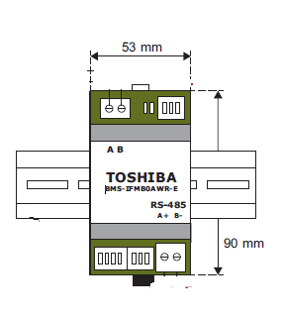
Dimensions

Slide 13
Wiring specification
Connection devices | No. Core | Size | Length | Polarity | Spec.
Between Hydro unit and MB Interface (AW-LINK) | 2 core | 0.75mm2 or More | Max 50m | No Polar | -
Between MB Interface and Upper side system (RS-485) | 2 core | 1.25mm2 or More | Max 500m | Polar | Shield wire

Slide 14
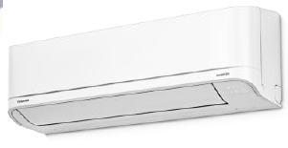
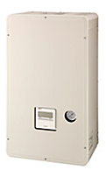
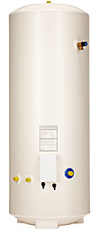
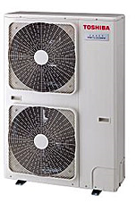
New
Procured by Locally
Wiring Diagram
AW-LINK

Slide 15
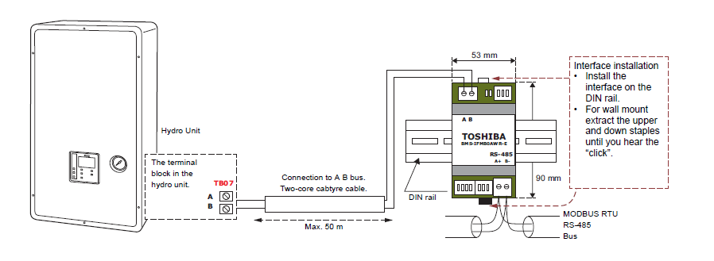
Install to DIN rail
Connect AB Terminal
AW-LINK
MAX 50m
Connect TB07 AB Line
RS-485
MAX 500m
Connect RS485 Termina lA+ B-
Length of stripped RS-485
and A B bus communication cable

Slide 16
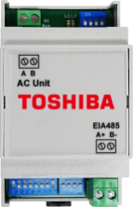
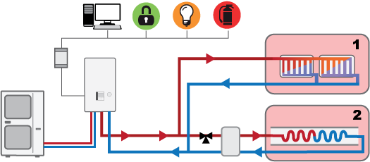
Note:
- 2nd RC cannot be connected together with Modbus®/KNX interface.
- Modbus®/ KNX interface can be connected to series 4 and series 5.
* Modbus® is a registered trademark of Schneider E.

Slide 17
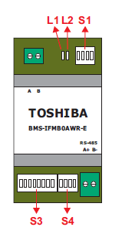
Device Setup
S1 Hydro Unit Type Setting
Bit1 | Bit2 | Hydro Type
OFF | OFF | 5 Series
OFF | ON | 4 Series
S3 Slave Address and Baud rate
Bit7 | Bit8 | Hydro Type
OFF | OFF | 2400 bps
OFF | ON | 4800 bps
ON | OFF | 9600 bps
ON | ON | 19200 bps

Slide 18
Device Setup
S4 Temp / Terminal Register Setting
Bit1 | Temperature Value Setting
 | OFF(*) | x1
 | ON | x 10 (ex. 28.5 deg --- 285 --- 0x11D)
Bit2 | Reserve
Bit3 | Reserve
Bit4 | RS-485 Terminal Resister
 | OFF(*) | No Resister
 | ON | 120 Ω

Slide 19
Contacts
For Pre-Sales and Controls Support:
Kevin Seaward - Pre Sales Senior Design Engineer
Bradley Legge - EMEA Controls Engineer
For After-Sales Technical Support:
Mark Davidson - Senior Technical Support Engineer
Mark Smith - Technical Support Engineer

Slide 20
Controls Solutions
Thank You
END

